Slide 1
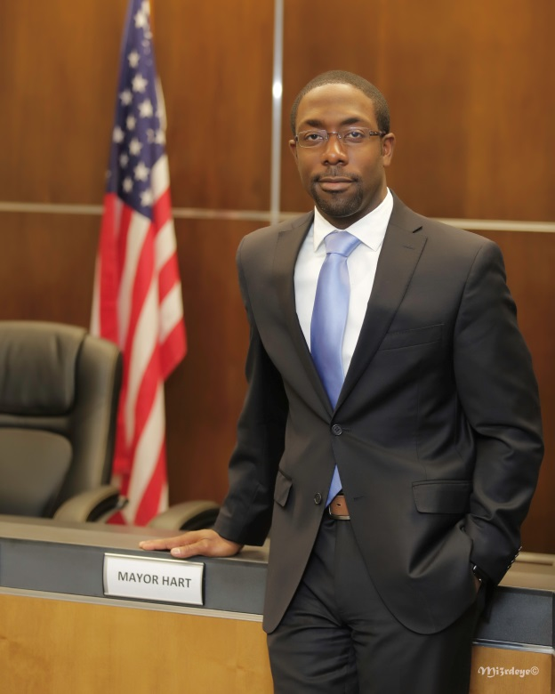
Mayor’s Office

Slide 2
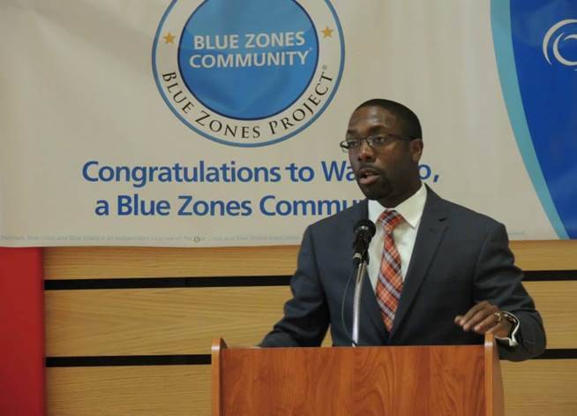
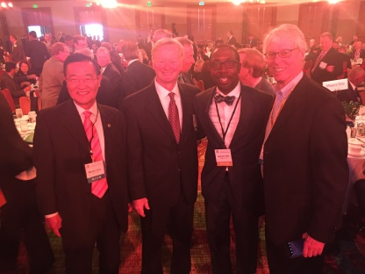
MISSION OF
THE MAYOR’S OFFICE

Slide 3
CEO of the City
Run a multi-million dollar, taxpayer-funded government entity for the citizens of Waterloo.
Chief Operations Officer over 500+ employees.
Direct Report for all department heads
“The mayor is the chief executive officer of the city and presiding officer of the council. Except for the supervisory duties which have been delegated by law to a city manager, the mayor shall supervise all city officers and departments.” – State of Iowa Code

Slide 5
Presiding Officer of the City Council
Ceremonial Representative of the City
Ribbon Cuttings: 25
Public Appearance Request: 125
Speaking Requests: 100
Media Interviews & Reoccurring
Segments: 75
-Mayoral Outreach: 25

Slide 6
Boards, Committees, Etc
U.S. Conference of Mayors
National League of Cities
Future Ready Iowa Alliance (by Governor Reynolds)
Iowa Dept. of Aging Board
Iowa League of Cities Executive Committee
Iowa League of Cities’ Legislative Committee
Iowa Workforce Development Minority Communities Board
Iowa State Workforce Committee
INRCOG Board & Executive Committee Greater Cedar Valley Alliance & Chamber Board ExOfficio
Leader Valley Council
Regional Innovation and Entrepreneurship Team Member
Regional Workforce Development Board
Black Hawk County Conference Board
Black Hawk County Emergency Management Agency
Black Hawk County Share Services Committee Cedar Valley Coalition
Community Foundation’s Metro Funders
Future Ready Cedar Valley
UNI Strategic Plan Implementation Team
Waterloo Youth Jobs Initiative

Slide 7
Executive Secretary
to the Mayor – Michelle Westphal

Slide 8
Depending on if there is a crisis, calls can range anywhere from 30 to over 60 per day.
Provide confidential assistance to the Mayor.
Screen phone calls and visitors to the Mayor’s office.
Screen phone calls and visitors to the Legal Dept.
Assist citizens by directing toward the appropriate department or agency (walk-ins or on phone).
Research and/or follow-up on citizen complaints/requests.
Keep Mayor’s calendar--schedule meetings internal and external.
Boards and commissions: Keep listing current; send updates to website staff; receipt and route applications to appropriate departments; gender compliance; monthly send openings to League of Women Voters for Courier publication.
Send press releases.
Facilitate block party requests.
Budget: Work with annual budgeting process; accounts payable
Facilitate 30yr plaque presentations at Council
Facilitate invocations schedule
Compose correspondence/emails
Routine secretarial duties

Slide 9
Communications Director (part time)
Wendy Bowman

Slide 10
Strategic Goal 4: Enhance the image of Waterloo and the City to residents and businesses inside and outside of the community.
Strategy 4.1: Establish a City marketing and communications team responsible for promoting the City of Waterloo, its departments, services and programs.
Strategy 4.2: Develop a marketing and communications plan for the City of Waterloo targeting residents and businesses.

Slide 11
City Communication & Marketing Plan –
Communications Committee: Waterloo Image Team: Main Street, Waterloo Schools, Experience Waterloo, Waterloo Center for the Arts, and Hawkeye Community College
Public Relations:, 51 Press Releases, Spring 8 Week Residents Academy/ Fall 2 Day Residents Academy, 7 - Mayor’s Coffee’s
Economic Development Marketing –Development Update x4,
Departments: Assisted Community Development with Lead Grant campaign
Apply for awards & recognitions: Grand Crossing Award Applications x2, Commercial – Jefferson Street Scape Application & Video Presentation
Special Events: Produced State of the City, Mayor’s Fireworks, City Staff Strategic Planning Session & Retreat, Youth City Council Inaugural Event
Assists with website maintenance and strategy
Advises & Assists Daily Communications on Hot Topics, Special Initiatives, Events, and Public Education

Slide 12
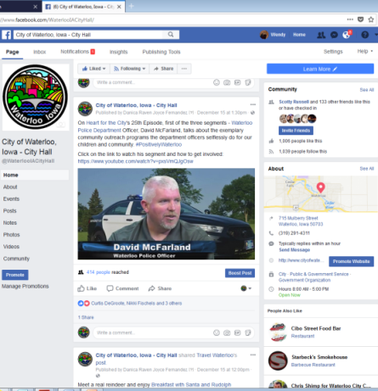
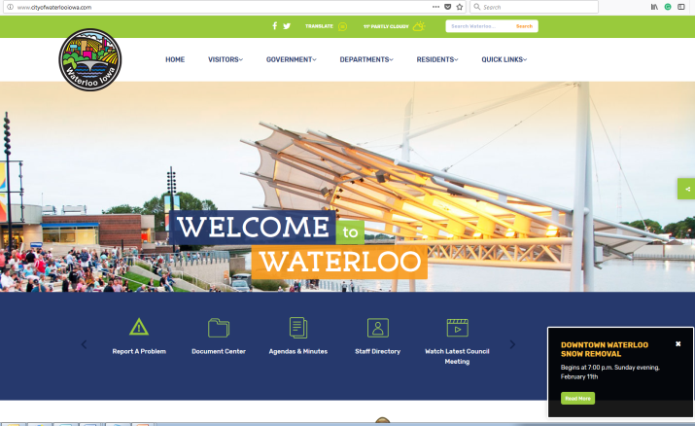
SOCIAL MEDIA
2,375 followers
+ 1,226 over last year
281 followers
+183 over last year
369,448 page views
+ 113878 over last year

